Slide 1
Cloud Based Bus Pass System
Guided By- Mr. Vijendra Singh
Industry Mentor- Yogesh Ghorpade
1

Slide 2
Team Members
Team Members | Roll No. | Course
Gaurav Porwal | R110219054 | B.Tech CSE CCVT
Anirudh Kushwah | R110219015 | B.Tech CSE CCVT
Kushagra Joshi | R110219061 | B.Tech CSE CCVT
Nayan Naugain | R110219090 | B.Tech CSE CCVT
Kumar Baibhav | R110211074 | B.Tech CSE CCVT

Slide 3
Introduction
The cloud based bus pass system is developed with the help of Express,MongoDB,Node.js and for frontend HTML,CSS and JavaScript.
The cloud based bus pass system is designed with a user friendly interface.
The main purpose of this project is to automate pass issuing procedure and enable safe and secure and safe payments as well through the use of UPI’s.

Slide 4
Project Objectives
This project objective is to use a cloud based buss pass system for booking tickets which is user-friendly and easy to use.
Users can issue their bus passes online without waiting in long queues to get their passes.
The passes are generated online so the chance of getting them misplaced or stolen is minimal.

Slide 5
Motivation
One of the primary issue in the process of physically getting bus pass and tickets is that the user has to wait in long queues to submit their documents.
And only after verification the ticket/pass is issued.
With an online automated platform to issue pass and book ticket, the human intervention is reduced and hence chances of error are minimal.
Chance of tickets being misplaced or stolen is reduced as user carry an e-ticket.
This is a more convenient and user friendly process to book ticket.

Slide 6
Existing System
In the existing systems, pass generation and renewal was a manual process. The user had to visit the office and submit their details and wait for approval which is time-consuming.
People working 9-5 jobs and students going to colleges or schools had to wait in long queues to get their pass. This was not an efficient approach for the daily passenger in their day-to-day bus journey.

Slide 7
Proposed System
To overcome the drawbacks of the existing system, the proposed system has been evolved.
Here we use an online cloud based system to issue pass and book tickets for travel.
Users can register themselves over at the platform and then book ticket to their destination.
Users can access it from anywhere and make safe and secure payments through UPIs or Net-banking.

Slide 8
Hardware & Software Requirements
Hardware Components:
Primary Memory (RAM) - 4GB and higher
Secondary memory (ROM) - 5-GB and higher
Processor - Intel CORE i3 and higher
Software Components:
OS: Windows 10
Cloud: AWS, AZURE
Front end: Html, CSS, Java Script, Bootstrap
Back end: Cloud shell, Node JS, Express.JS, React.JS
Database: MongoDB

Slide 9
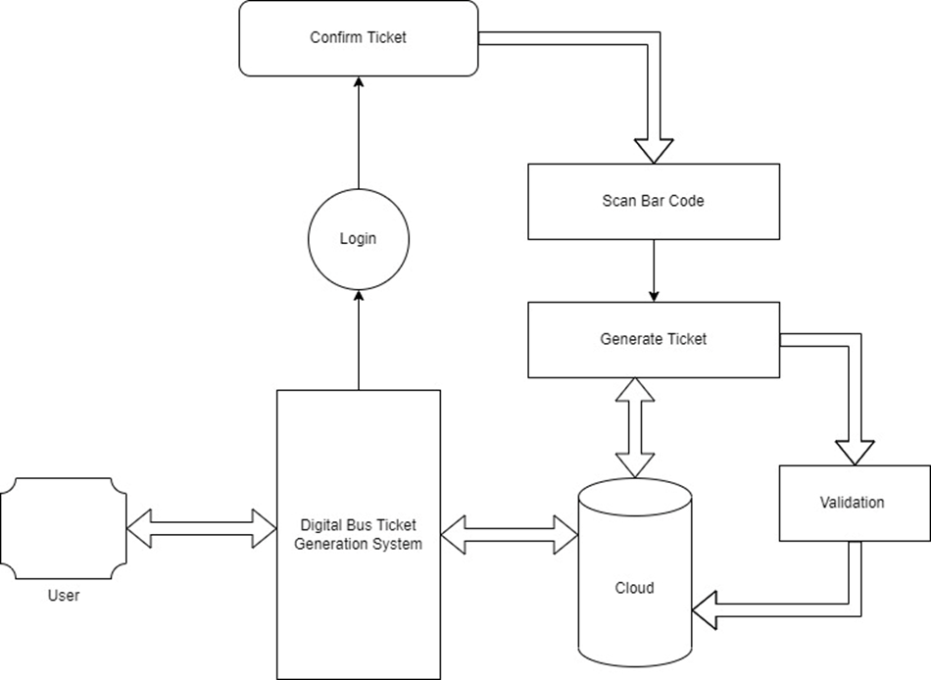
Process Flow Diagram

Slide 10
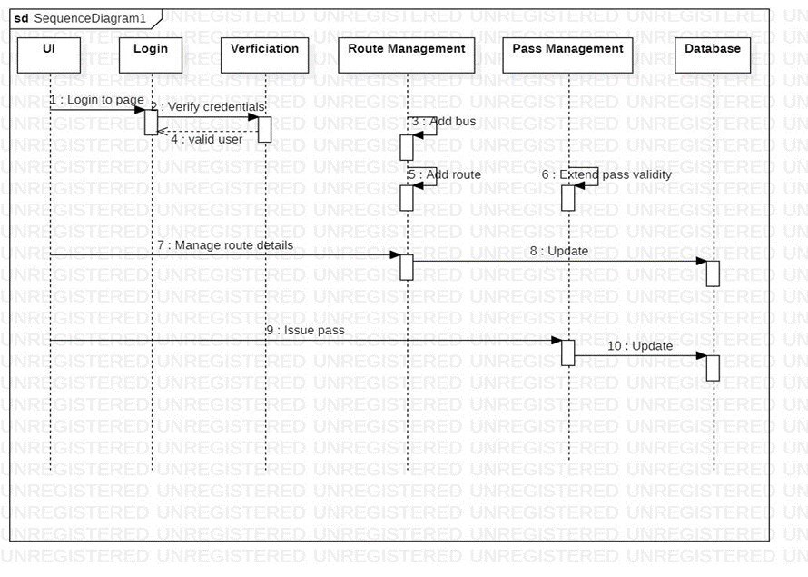
Sequence Diagram

Slide 11
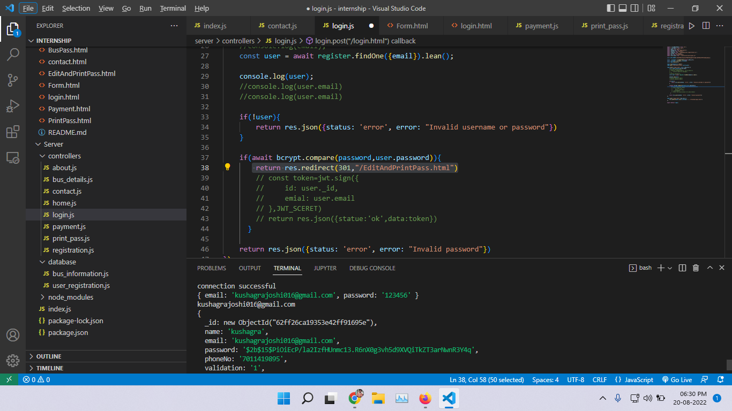
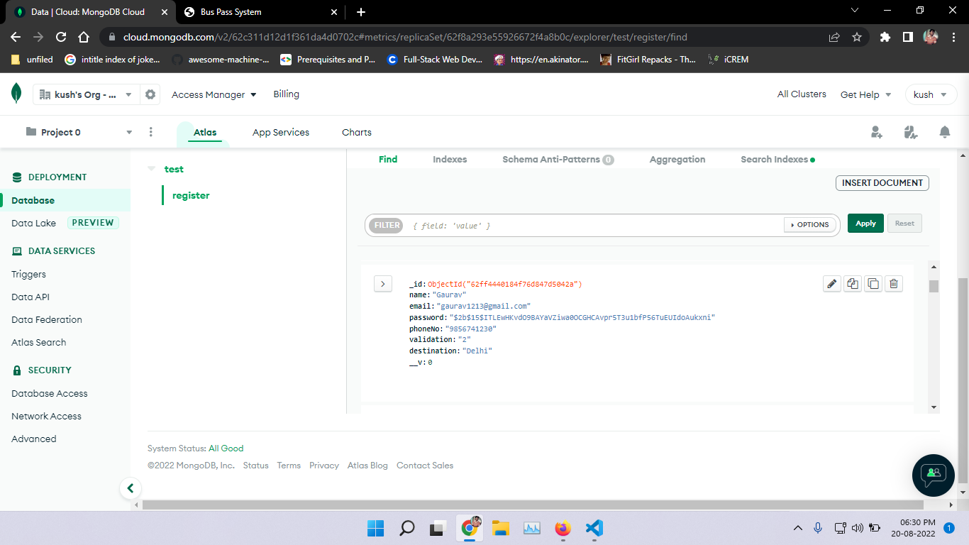
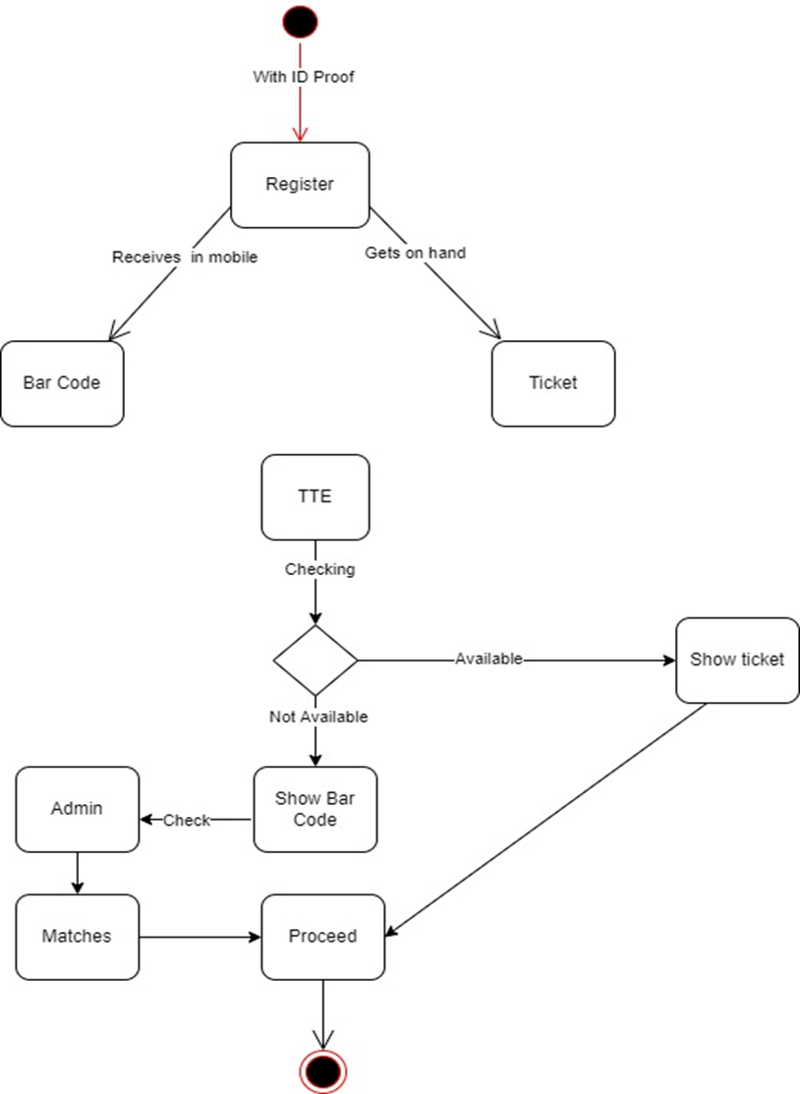
Activity Diagram

Slide 12
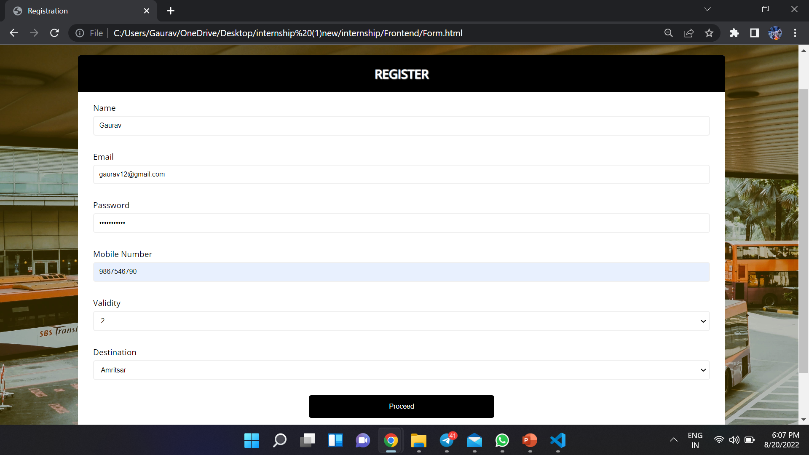
Snapshots
12

Slide 13
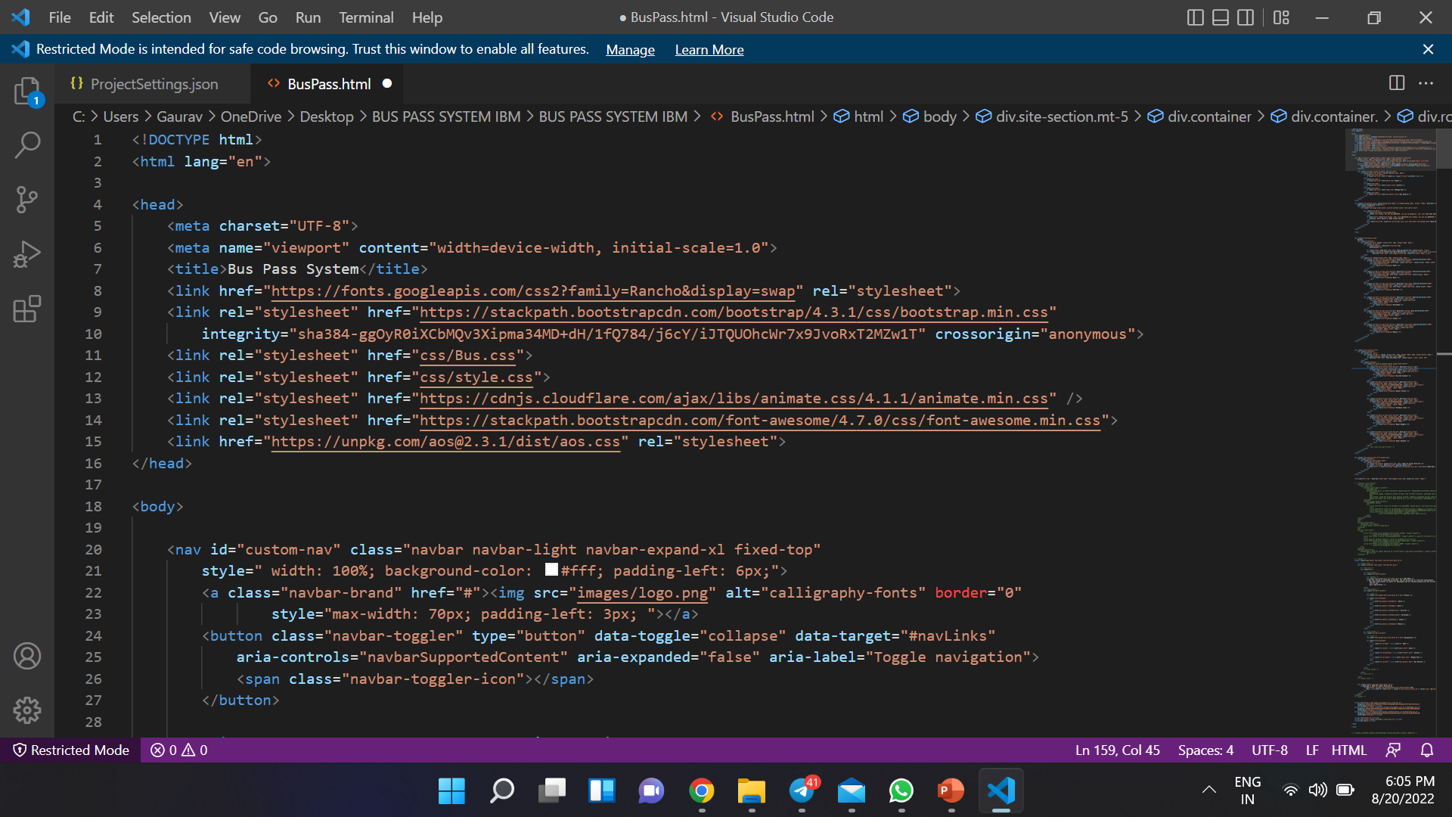
13

Slide 14
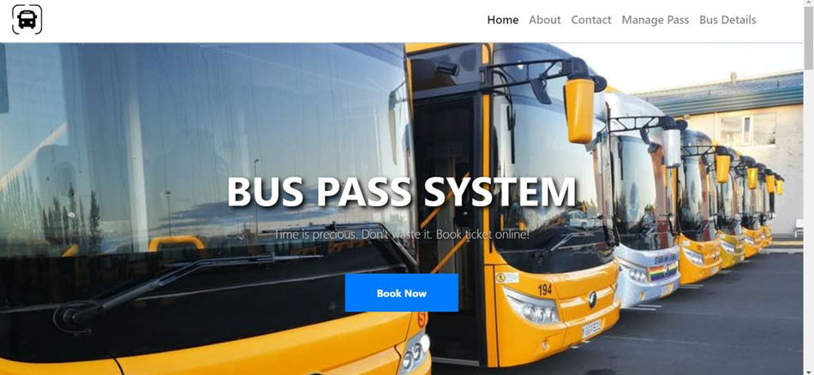
14

Slide 15
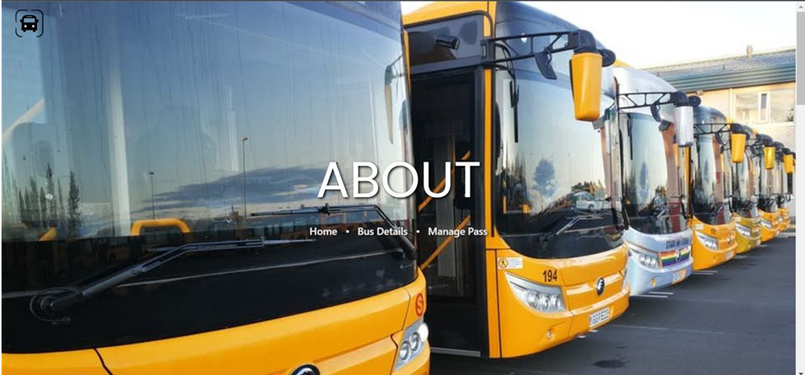
15

Slide 16
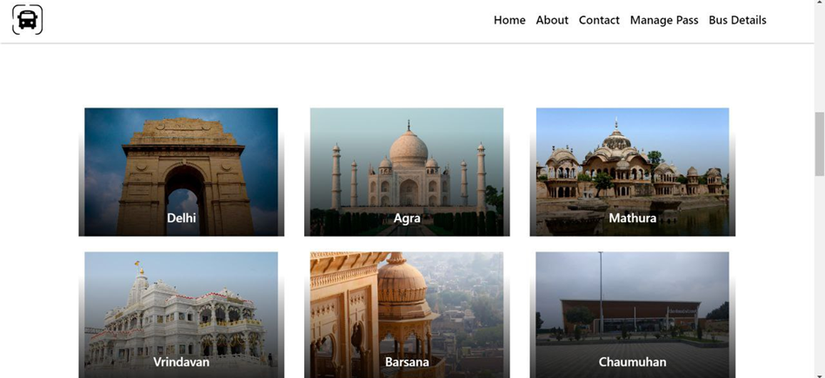
16

Slide 17
Conclusion
The proposed project aims to address the problem of manually issuing bus
pass and booking tickets. This method is a basic implementation of the
proposed methodology that can be improvised and customised according to
the needs. It proposes to use a cloud-based platform to issue pass and book
tickets. The users can access the system in real time and book tickets based on
their destination, route and departure time.

Slide 18
References
https://www.researchgate.net/publication/329073305_Cloud-Based_E
Learning_Using_Cloud_Computing_Platform_for_an_Effective_E-Learning
S. Kim, “Security Augmenting Scheme for Bus Information System based on Smart Phone”, International Journal of Security and Its Applications, vol. 7, no. 3,(2013), pp. 337-345.
(Accessed on 22 June 2022)
J. Lee, K. Hong, H. Lee, J. Lim and S. Kim, “Bus information system based on smart-phone Apps”, in Proc.of KSCI Winter Conference (2012), pp. 219-222.
(Accessed on 25 June 2022)
S. Chandurkar, S. Mugade, S. Sinha, M. Misal and P. Borekar, “Implementation of Real Time Bus Monitoring and Passenger Information System”, International Journal of Scientific and Research Publications, vol. 3, no. 5,(2013), pp. 1-5.
(Accessed on 25 June 2022)
18

Slide 19
Thank You!

